Slide 1


Success in software development
Knowledge and
Communication skills
Intelligence
Creativity
Efficiency
Abstraction skills
Management skills
Leadership skills
Well Organized
Just Knowledge

Slide 2
What is OOP?
See the real world as objects and implement these objects
as software objects.
Objects communicating with each other by sending and
receiving messages.
This is how the real world works!

Slide 3
UML
Unified Modeling Language
UML enables us to create blueprints(diagrams) of the different
aspects of the software development process.
Unifies popular modeling methods of the early ‘90:
  Booch (Grady Booch)
  OMT (James Rumbaugh)
  Objectory (Ivar Jacobson)
Industry wide acceptance
Consist of a number of diagrams
We focus only on the class diagram

Slide 4
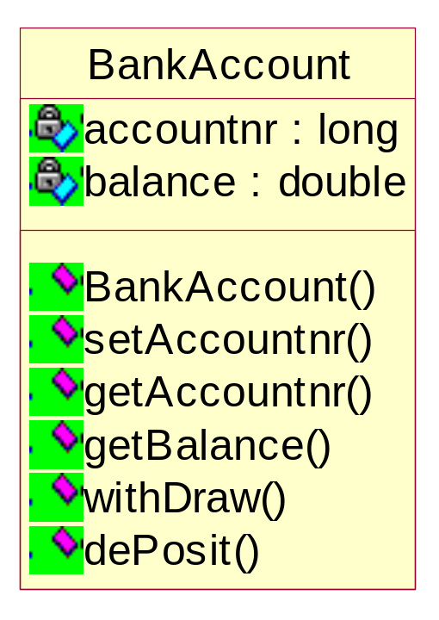
public class BankAccount{
private long accountnr;
private double balance;
public BankAccount(){
balance=0;
}
public void setAccountnr(long acnr){
accountnr=acnr;
}
public long getAccountnr(){
return accountnr;
}
public double getBalance(){
return balance;
}
public void withDraw (double amount){
balance=balance-amount;
}
public void dePosit (double amount){
balance=balance+amount;
}
}
private
classname
attributes
methods
public

Slide 5
Classes simulate real world object relationships with other classes.
A class diagram consists of classes and their relationship to each other.
Different kind of relationships:
Association
Aggregation
Composition
Inheritance

Slide 6
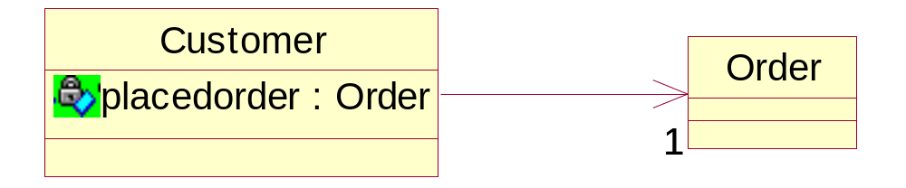
Association
Uni-directional
public class Customer{
private Order placedorder;
}
public class Order{
}

Slide 7
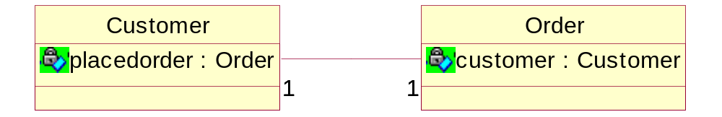
Association
Bi-directional
public class Customer{
private Order placedorder;
}
public class Order{
private Customer customer;
}

Slide 8
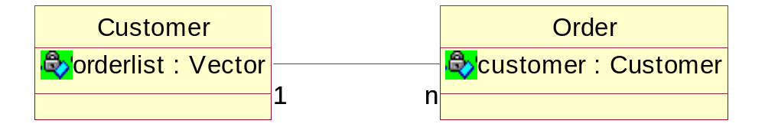
Association
Multiplicity
1 one
3 three
n many
0..n zero or more
1..n one or more
0..1 zero or one
public class Customer{
private ArrayList orderlist;
}
public class Order{
private Customer customer;
}

Slide 9
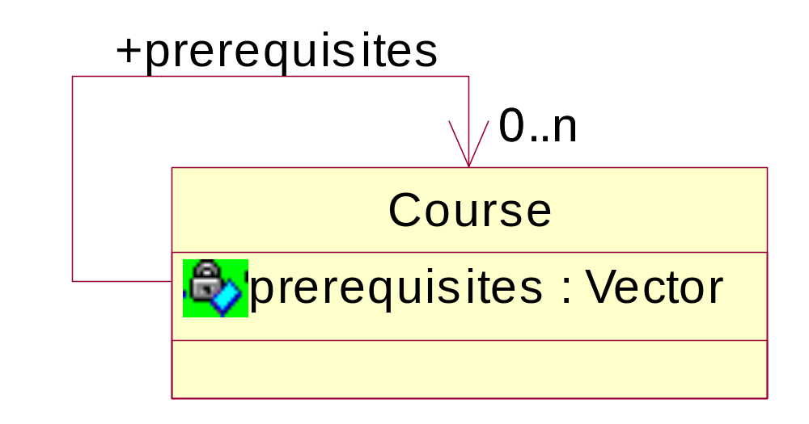
Reflexive Association
Association role
import java.util.ArrayList;
class Course
{
public Course() {}
// The unbounded multiple association is stored in an ArrayList
private ArrayList prerequisites;
}

Slide 10
Future of Object-Orientation
Software will become more complex.
OO has a good foundation to manage this complexity.
New tools will come up (based on OO).
More reuse in vertical markets.

Slide 11

Java
Characteristics of Java:
Simple
Object-Oriented
Portable across many platforms
Secure
Robust
Garbage collected
multithreaded
Distributed
Java code
Compile
byte code
Should have 3 different JVMs here!
JVM
Windows
Unix
Linux

